Slide 1
Classes
Part 1
Creative Commons Attribution-NonCommercial-ShareAlike 3.0 Unported License. http://creativecommons.org/licenses/by-nc-sa/3.0/
Written by Rachel J. Morris, last updated 2015-01-14

Slide 2

Classes
Classes are similar to structs, but have more sophisticated functionality, if you choose to use it.
You can write a class that is exactly the same as a struct, so for simple data, it's up to you which one you want to use.

Slide 3
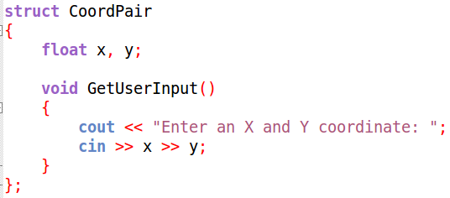
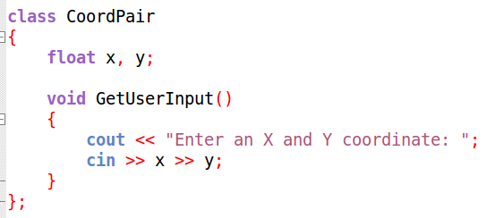
Classes
Declaring a class looks similar to a struct...
However...

Slide 4
Classes
Make a small program with a struct.
Then change it to a class.
Build errors due to privacy.

Slide 5
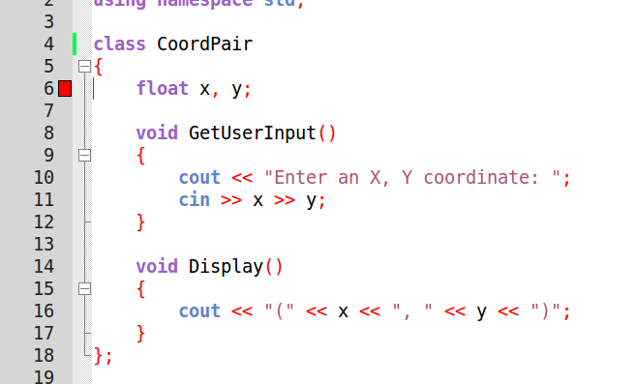
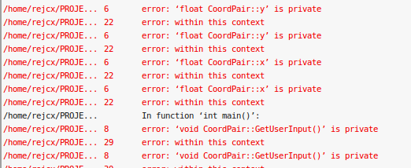
Classes
What happened when we changed “struct” to “class”?

Slide 6

Accessibility

Slide 7
Private and Public Members
By default, structs have public member variables and functions.
For classes, private member variables and functions are the default.
Any private variables or functions are not accessible outside of the class – only from within the class itself.

Slide 8
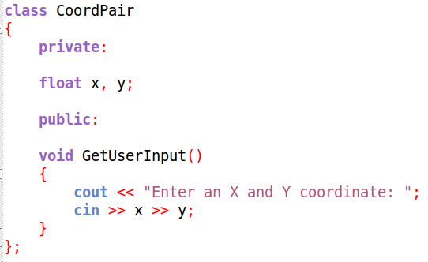
Private and Public Members
We can take advantage of public and private members by hiding the inner-workings of an object, and only displaying functionality that the user (or another programmer) would need.
More on the “whys” in a lecture on design...
We can explicitly what part of a class is public and private.
Private
Public

Slide 9
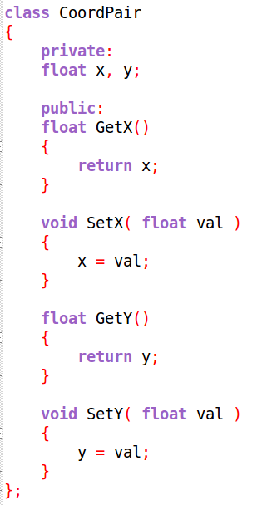
Getters and Setters
It is generally a good idea to make
member variables private,
and only make them accessible through a function “in-between”.
These are generally called
Getters and Setters
Or
Accessor and Mutator functions.
Keep this in mind for later.

Slide 10
Defining Member Functions

Slide 11
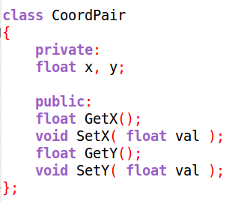
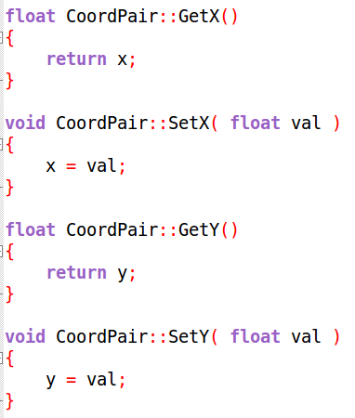
Defining Functions
While you can define your member functions from within the class,
It is generally more standard in C++ to only declare functions within the class.
Then we can define the member functions outside of the class...

Slide 12
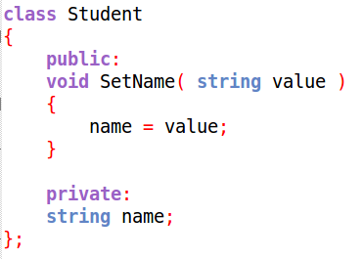
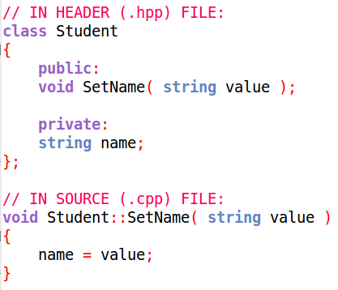
Defining Functions
Defining everything within the class
Defining functions outside
We do this because, in C++, we store the declarations in one type of source file (.hpp), and the definitions in another type (.cpp).
More on this in the lecture on using multiple files.

Slide 13
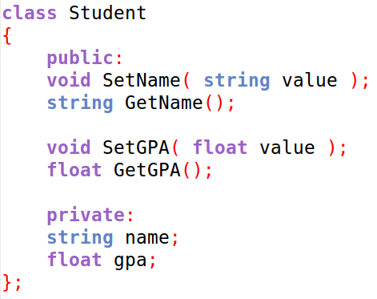
Defining Functions
So your class declaration should have
Member variable declarations
And
Member function declarations
But not the function definitions.
Remember that the definition is when we have the function body and inner code. The declaration is only the function header, with a semicolon at the end.
Remember that the definition is when we have the function body and inner code. The declaration is only the function header, with a semicolon at the end.
The user will interface with the Student object via its public functionality
Within the class declaration, functions are not defined.
Behind-the-scenes code is kept private.

Slide 14
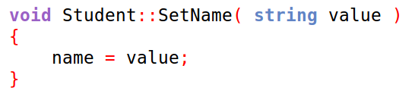
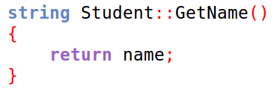
Defining Functions
The function definitions are written outside of the class – usually in a separate file.
Remember that the definition is when we have the function body and inner code. The declaration is only the function header, with a semicolon at the end.
Notice that when we define the functions in this way, we need to prepend the class name, followed by the
scope resolution operator ::
This is for functions that are members of a class. Not for functions as a whole.

Slide 15
This is only scratching the surface of classes.
There's still a lot more to cover, but for now we should do some sample programs!
Classes are very important, so make sure that you practice a lot!

Slide 16
Sample Programs...
Let's write some code to demonstrate how to use classes
A. Chat Log
B. Fractions
C. Game Entity

Slide 17
Sample Programs...
Let's write some code to demonstrate how to use classes
A. Chat Log
B. Fractions
C. Game Entity

Slide 18
Sample Programs...
Let's write some code to demonstrate how to use classes
A. Chat Log
B. Fractions
C. Game Entity

Slide 19
Sample Programs...
Let's write some code to demonstrate how to use classes
A. Chat Log
B. Fractions
C. Game Entity

